Slide 1




JA
RVIS
Job AI Ready Virtual Interview System
Developed By : Manish Jangid
Organization : NeoSoft Services
Mentor : Ms. Kalyani Sahastrabuddhe
www.jarvis.com

Slide 2
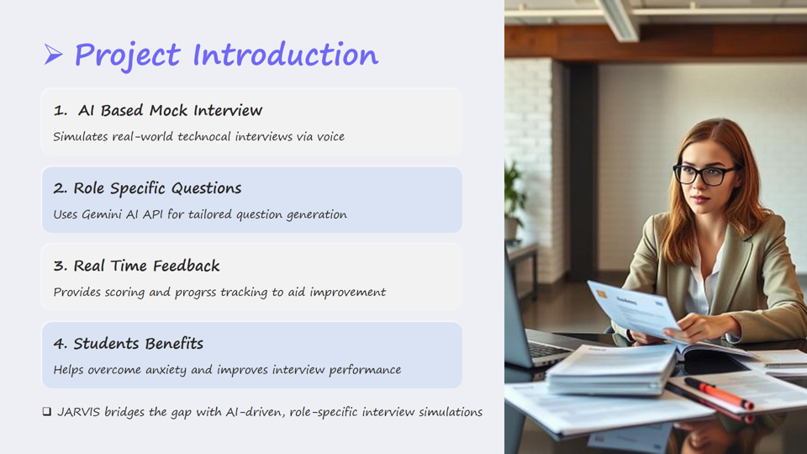

Slide 3
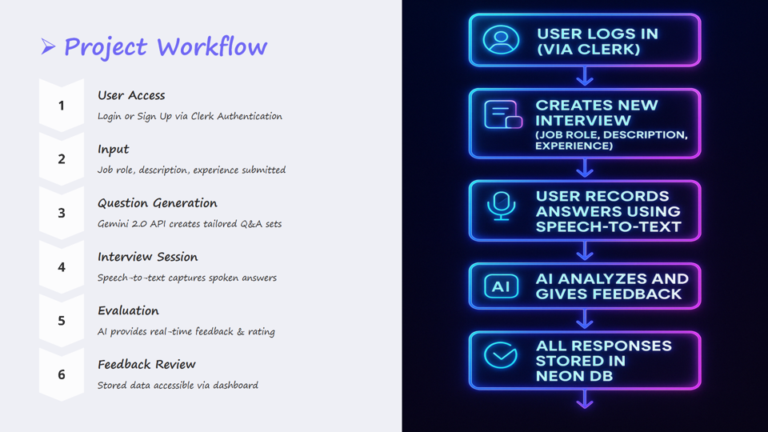

Slide 4

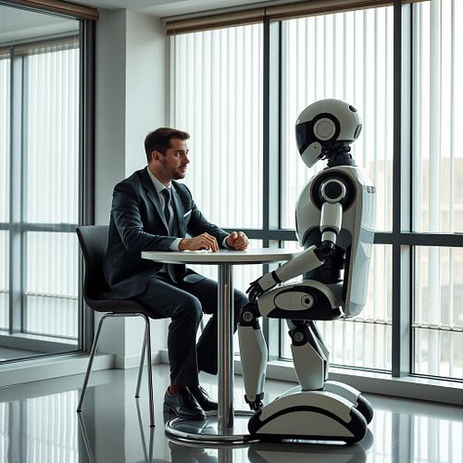
PROBLEM
STATEMENT
Students often experience anxiety, a lack of confidence, and difficulty crafting structured responses during interviews.
SCOPE OF
WORK
TECHNICAL
STACK
ROLE BASED QUESTIONS
1.
Frontend : Next.Js, Tailwind CSS, ShadCN UI
Backend :Drizzle ORM, Neon DB, Postgresql
Authentication : Clerk
Libraries :React Text-to-Speech
The AI will generate will generate the questions based on the job title, description and the experience of the user.
2.
SPEECH & VIDEO RECOGNITION
The user can record the answer of each question by voice & video input using react speech-to-text hook library, MediaRecorder API, and react-webcam.
3.
REAL TIME FEEDBACK
The AI analyzes the user answer and give back the expected answer, need of improvement and rating of each question in the feedback Report.
www.jarvis.com

Slide 5

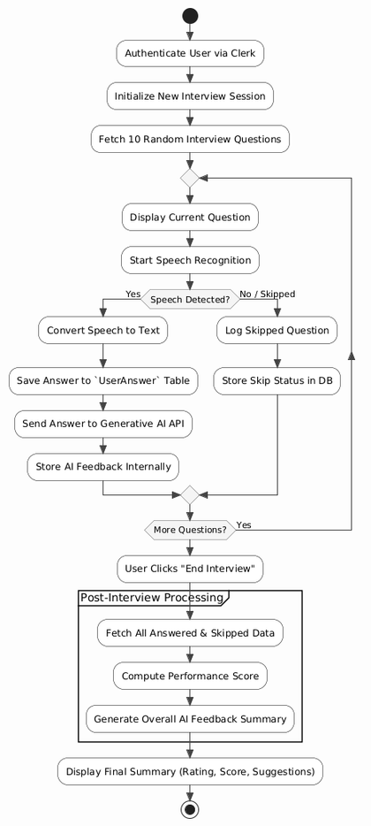
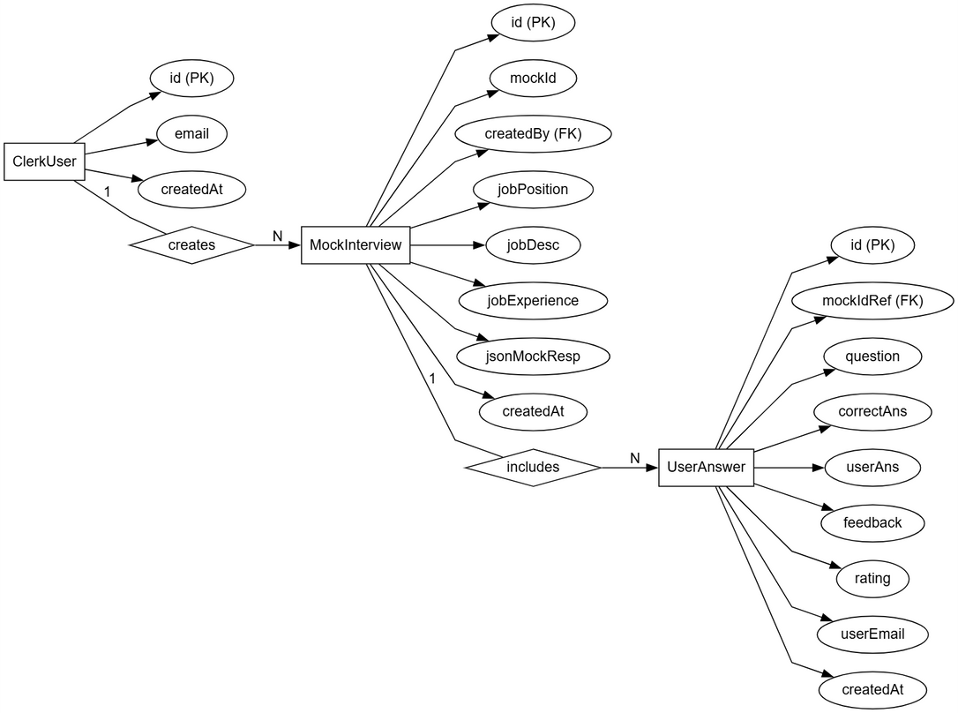
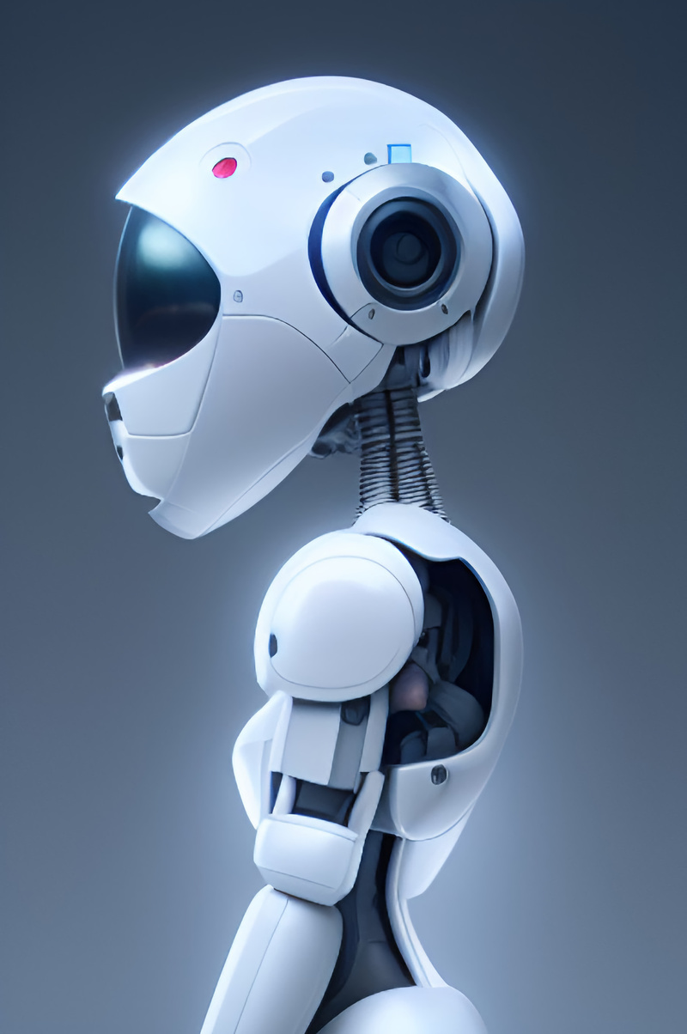

DESIGN
DOCUMENTATION
1.
ACTIVITY DIAGRAM
2.
ER DIAGRAM
www.jarvis.com

Slide 6
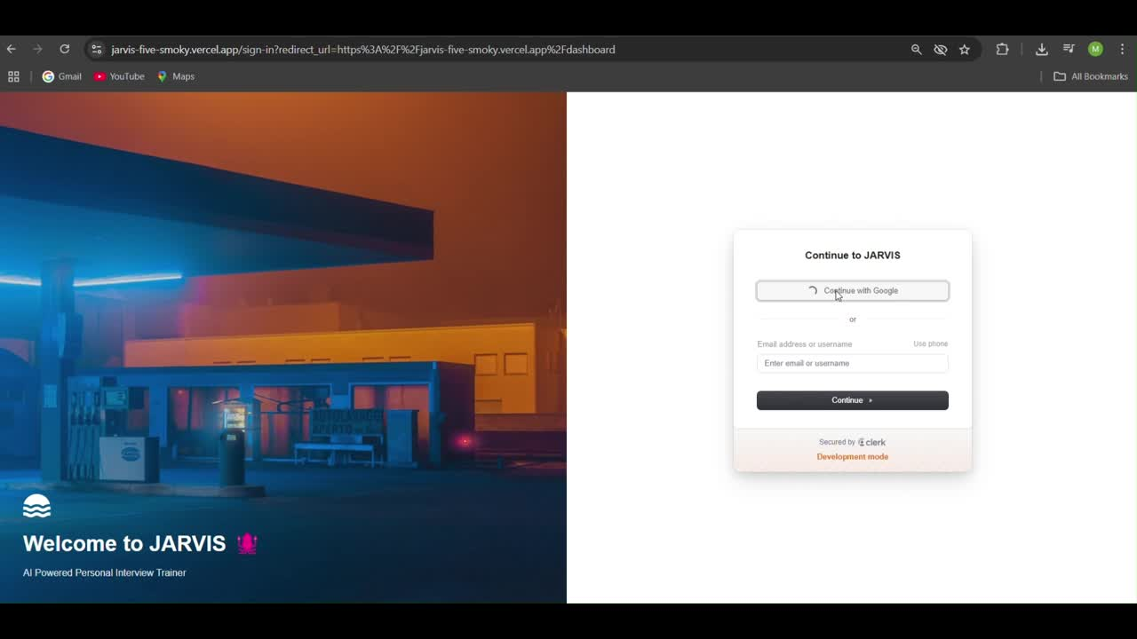
START
INTERVIEW...

Slide 7

CON
FUTURE
ENHACEMENTS
CLUSION
REAL TIME MOCK INTERVIEW SIMULATION
MOCK CODING INTERVIEW ADD-ON
1.
1.
JARVIS effectively replicates real interview experiences using voice and webcam features.
Adding code editor, Real time compiler would help interviewers analyze the candidates on different parameters.
INTELLIGENT FEEDBACK MECHANISM
RESUME BASED QUESTIONS
2.
2.
AI powered analysis helps user improve by evaluating fluency, accuracy and relevance.
Plan to add Resume as Input so the questions are generated on the basis of Resume and the projects.
SEAMLESS USER EXPERIENCE
DYNAMIC INTERVIEW AGENTS
3.
Built with NextJS, Drizzle ORM, Clerk ensuring fast and secure performance.
3.
Agents which act like real interviewer, adjusts questions based on user answers.
www.jarvis.com

Slide 8
THANK
YOU!
We appreciate your interest in JARVIS.
Looking forward to enhancing interview prepartion with AI.
www.jarvis.com

